Slide 1
ADEPT
Amani Konduru
Benjamin Garber (Daniel)
Edward Bull
Paul David Utesch
Team
Software Engineering- CSC 4350
Spring 2017
4/24/17

Slide 2
Roles- ADEPT
Amani Konduru: Project Manager, Tester, Document handler and Database
Daniel Garber: Developer
Edward Bull: Developer and Tester
Paul Utesch: GUI and Database

Slide 3
Overview
Secured email system
Client / Server pair
Communicates over secure TLS connections
Encrypts local storage
Secure password storage

Slide 4
Packages and tools
Programing Language: JAVA
GUI: JavaFX
Database: SQLite and PostgreSQL
Repository: GitHub
IDE: Eclipse
Agile Management System: VersionOne
Cloud: Digital Ocean (Droplet)

Slide 5
Using VersionOne to manage a team
VersionOne is an Agile product management tool
The product development cycle is broken into Stories
Each Story has a number of Tasks
Over discrete sets of time (Sprints) users sign up for and complete Tasks
When all of a Story’s Tasks are complete, the Story is marked as complete
When all of a Products Stories are complete, the current iteration of the Product is released

Slide 6
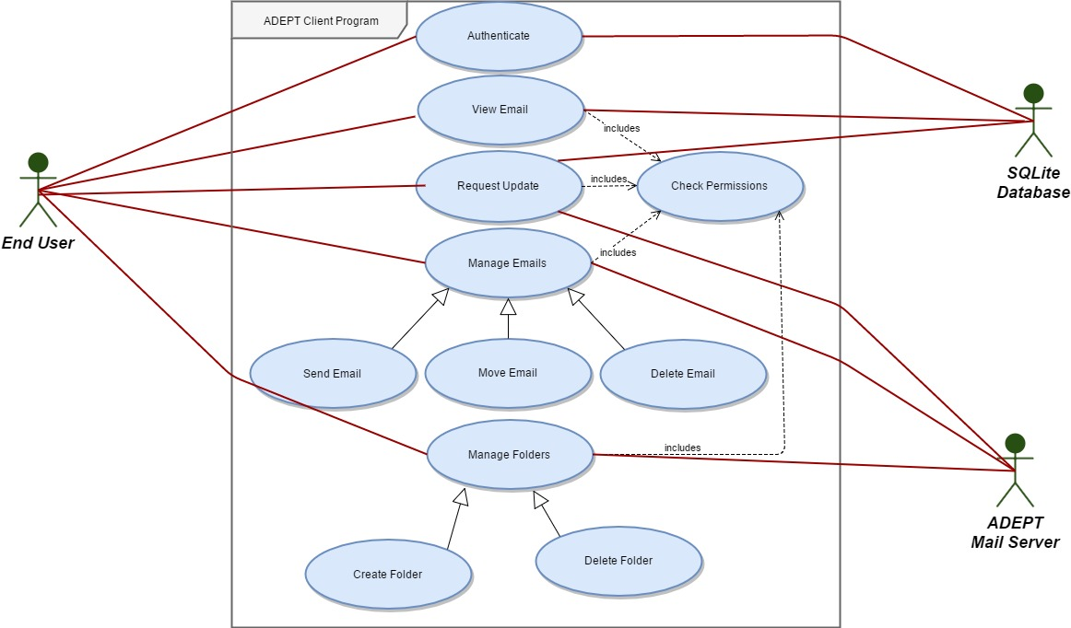
Use Cases - Client

Slide 7
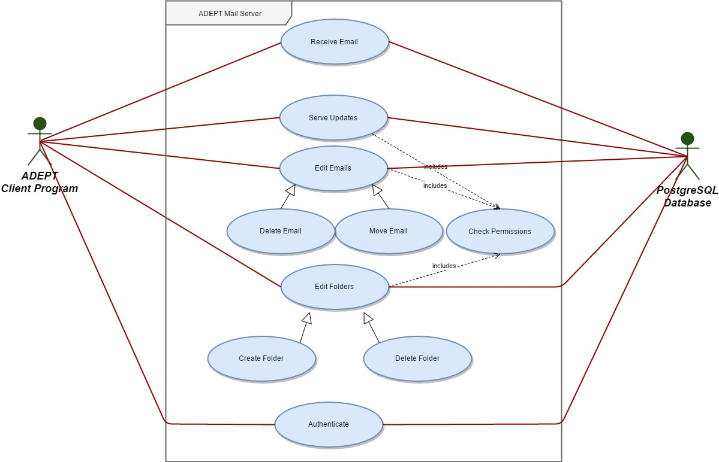
Use Cases - Server

Slide 8
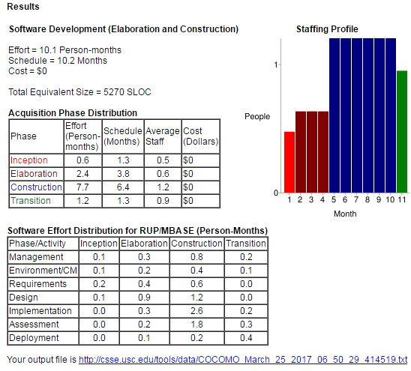
COCOMO
Effort is approximately a year
Some features (sending external emails, full certificate validation) had to be cut.

Slide 9
What is encryption?
Pig Latin but harder
Has a key
Can be symmetric (one key) or asymmetric (public/private key pair)
Can be used to verify identify using an asymmetric handshake
TLS, AES

Slide 10
What is hashing?
One way transformation
(if the algorithm is modern and secure)
Few collisions
SHA-256 (SHA2)

Slide 11
What is a relational database?
Stores data
Structures data based on relations between discrete atomic values
Allows for constraints and the modeling of relationships
PostgreSQL, SQLite

Slide 12
What is a Internet protocol?
Standardized set of requests and responses
Allows for interoperability between implementations
RFC documents to the Internet Engineering Task Force (IETF) and the Internet Society (ISOC)
IMAP – RFC 3501 and others (ex RFC 6851 for UID MOVE)
SMTP – RFC 5320

Slide 13
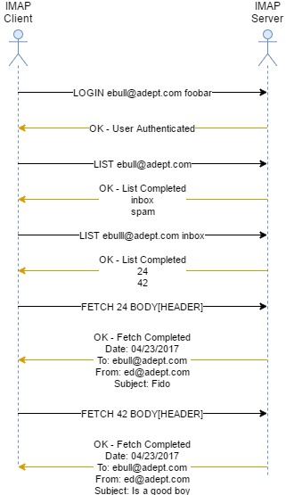
IMAP
Listing and retrieving emails
Deleting and moving emails
Creating, deleting, and renaming folders

Slide 14
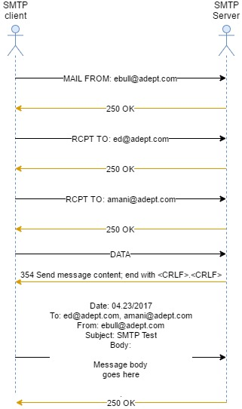
SMTP
Used for sending and receiving emails
Often used by mail servers to communicate to other mail servers, not just clients.

Slide 15
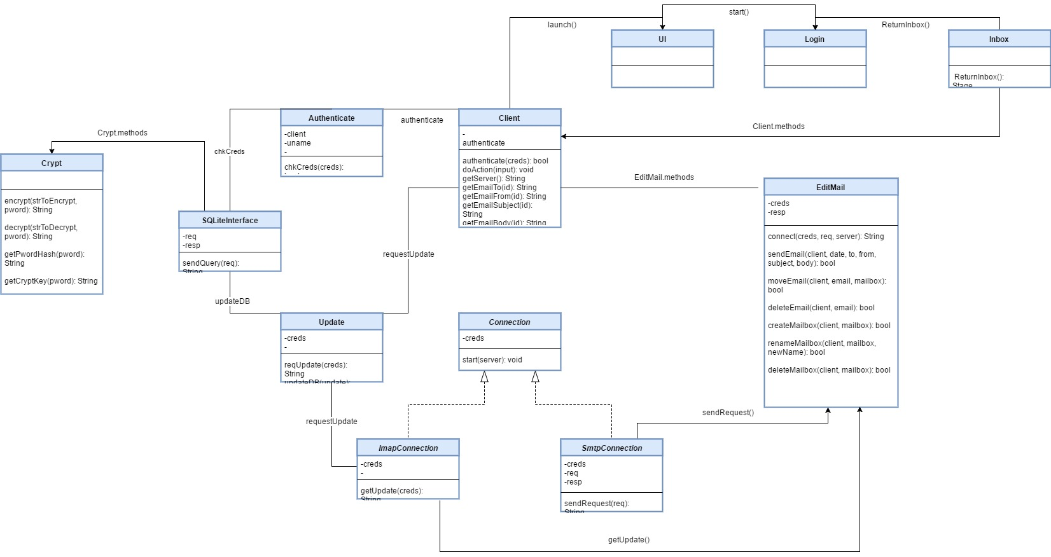
Client Class Diagram

Slide 16
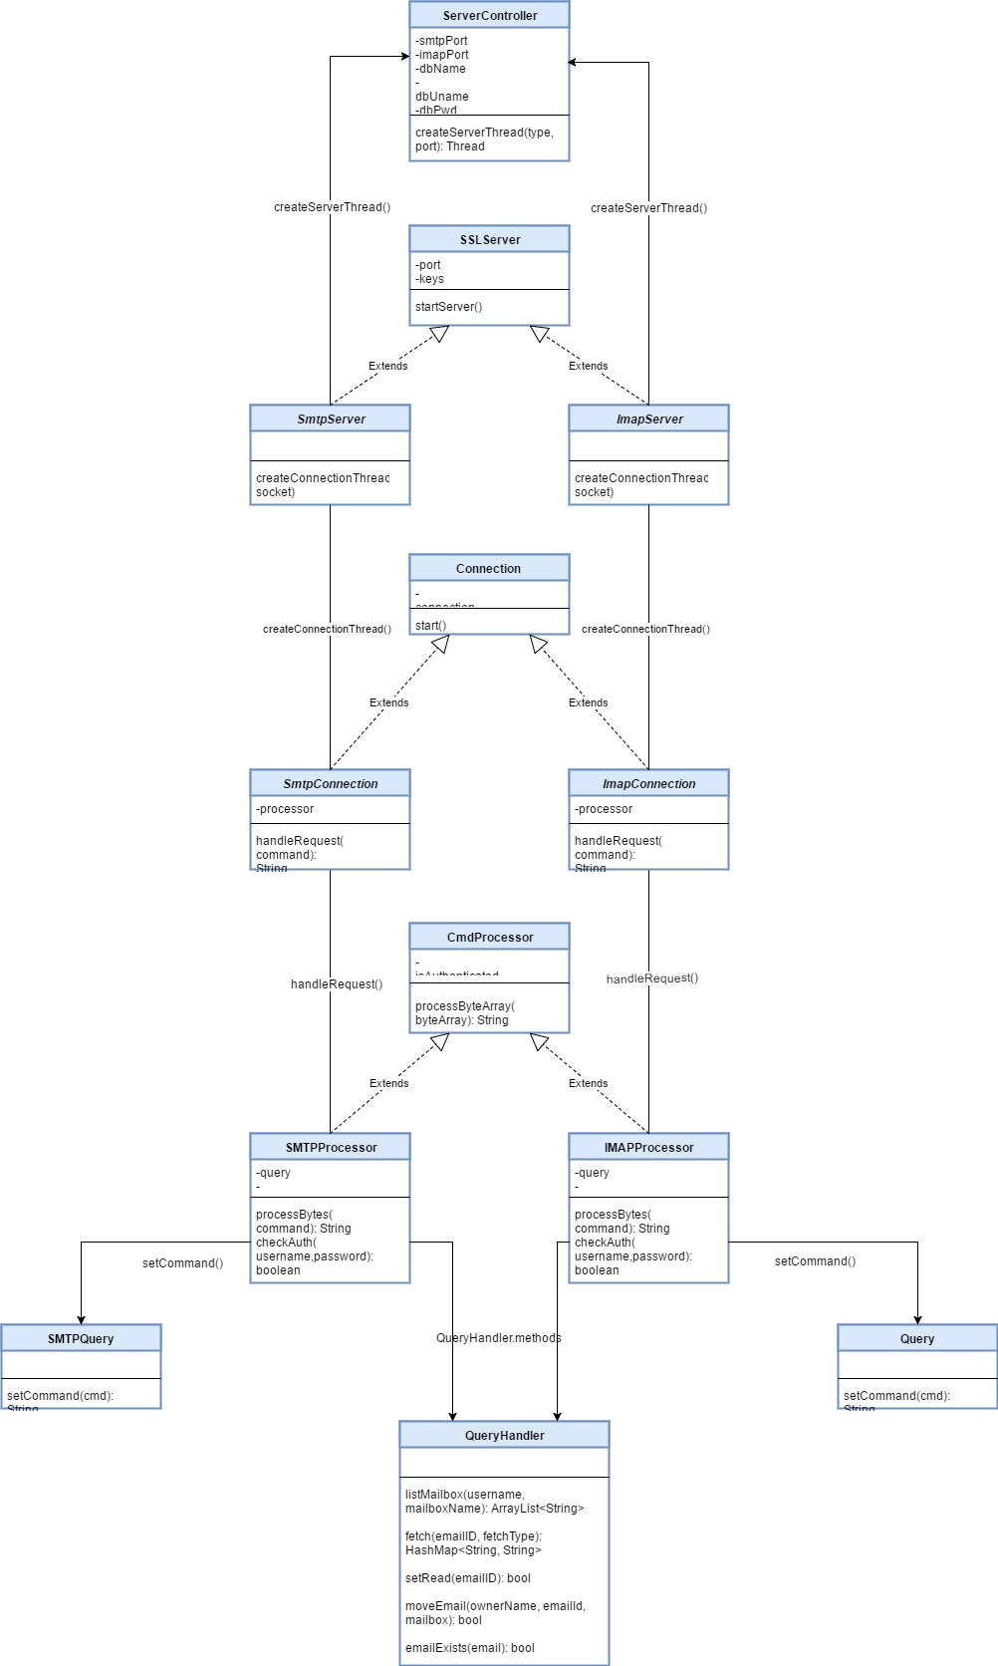
Server Class Diagram

Slide 17
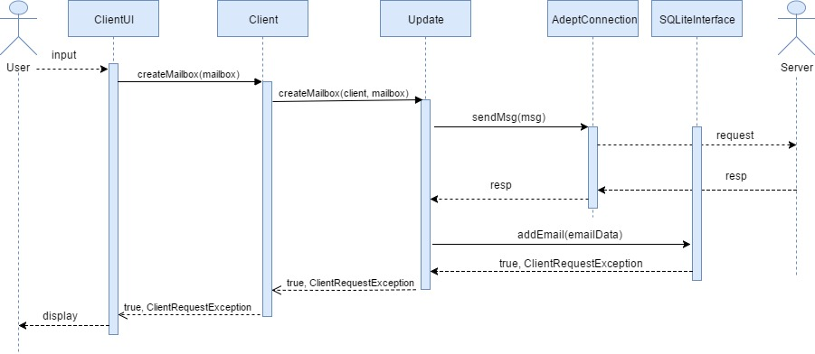
Client Update Diagram

Slide 18
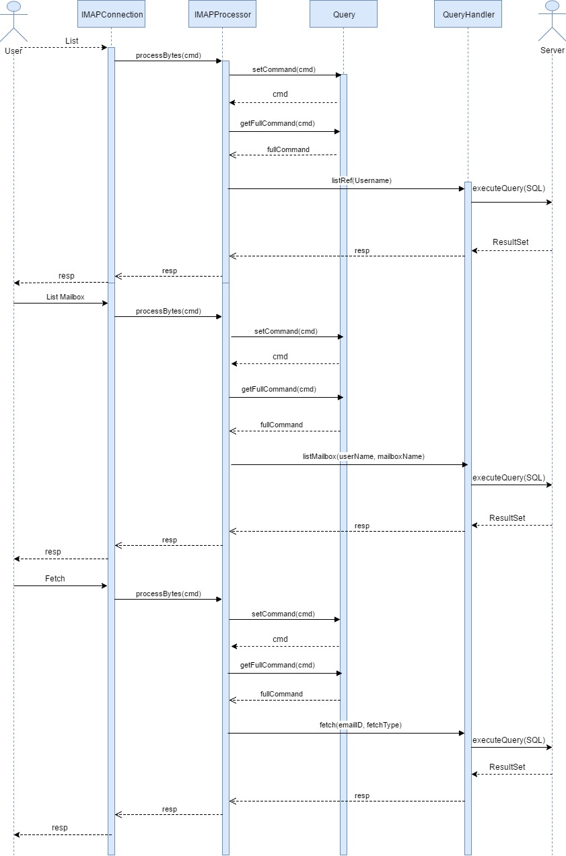
Server Serve Update Diagram

Slide 19
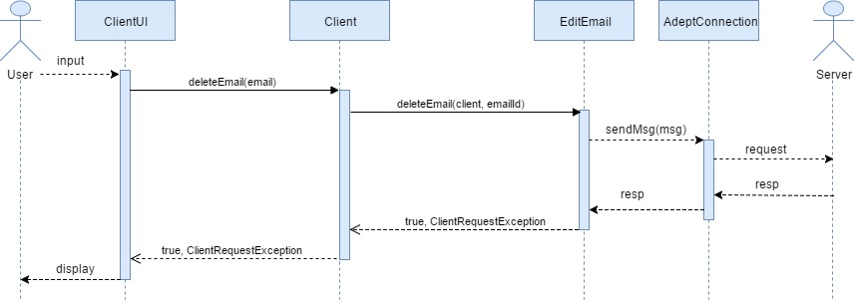
Client Delete Email Diagram

Slide 20
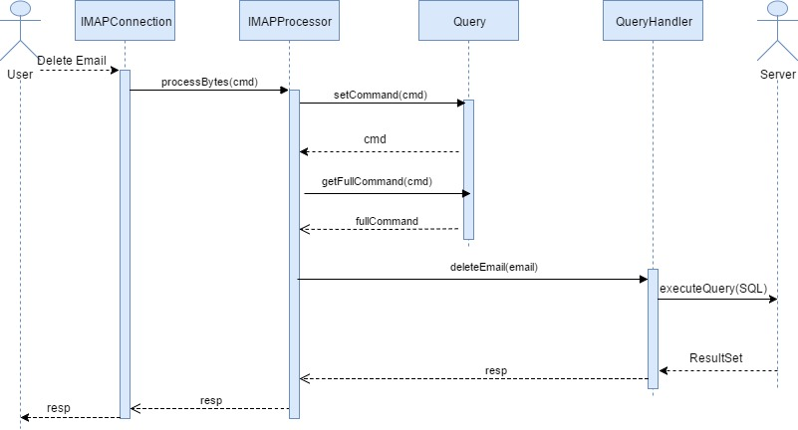
Server Delete Email Diagram

Slide 21
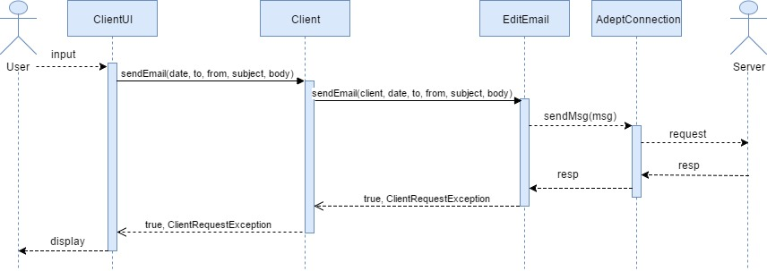
Client Send Email Diagram

Slide 22
Database Rationale
PostgreSQL vs SQLite
Concurrency
Ease of use
Speed

Slide 23
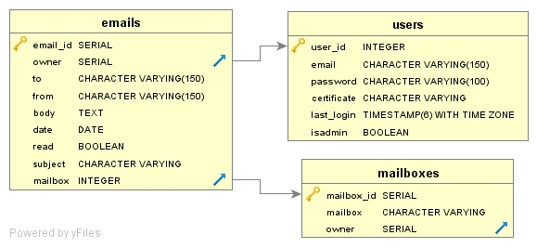
Database Implementation
PostgreSQL
Supports up to 100 concurrent connections by default, even on a Digital Ocean droplet with only 250B of memory

Slide 24
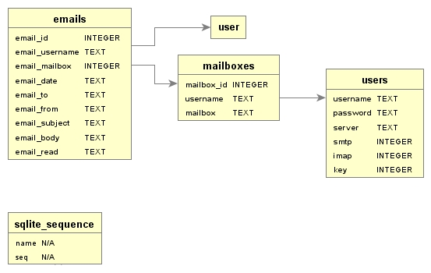
Client Database
SQLite
Speed
Ease of use
No need for concurrency

Slide 25
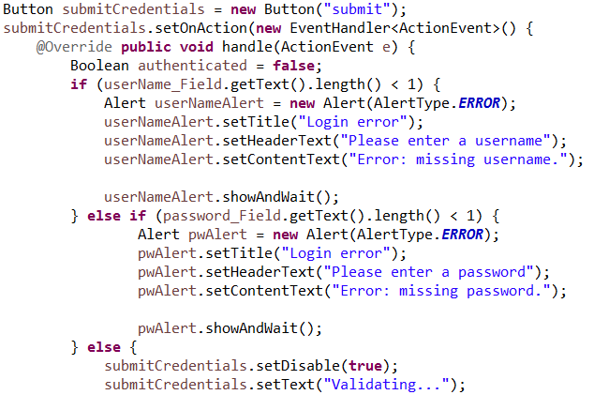
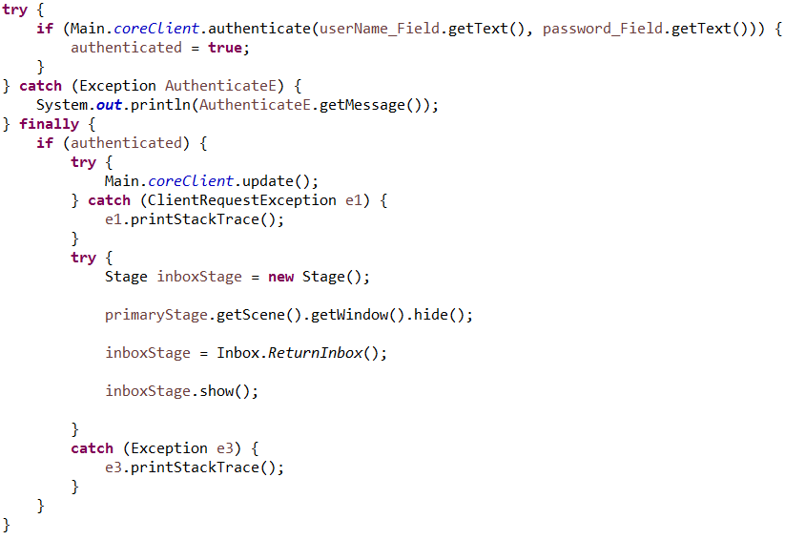
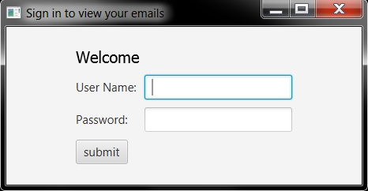
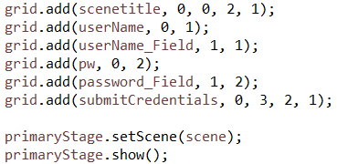
Login Screen

Slide 26
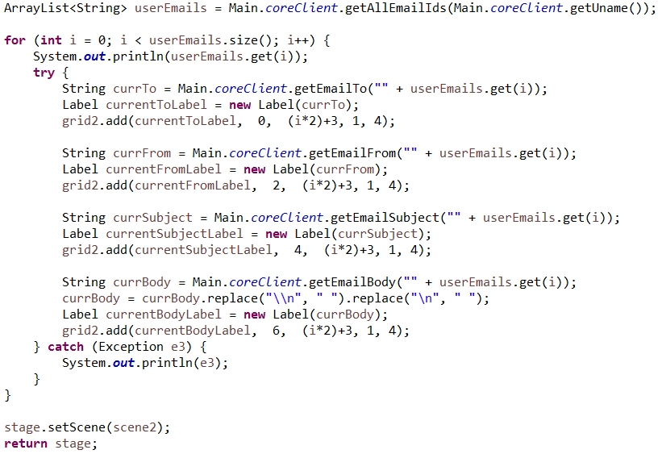
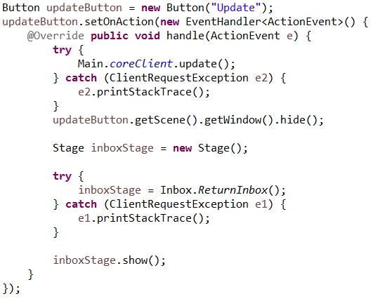
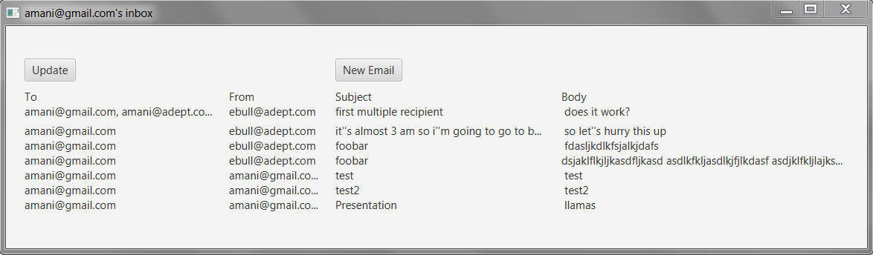
Inbox

Slide 27
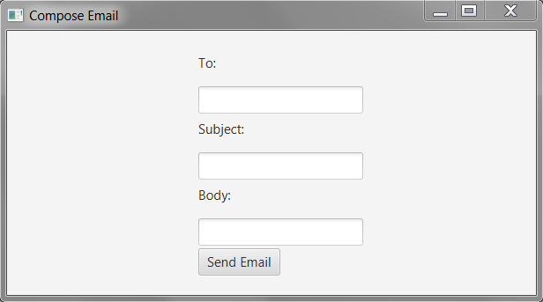
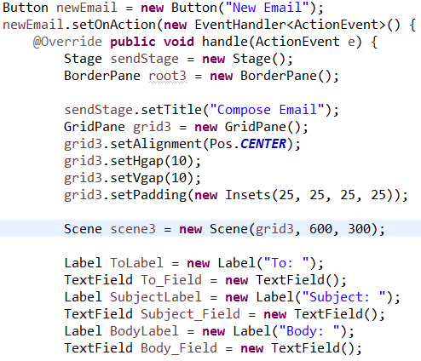
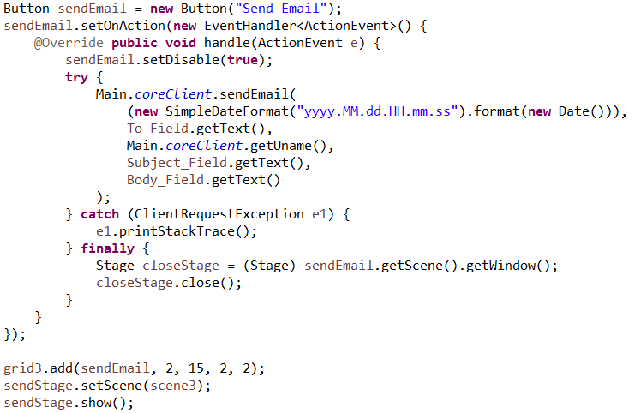
New Email

Slide 28
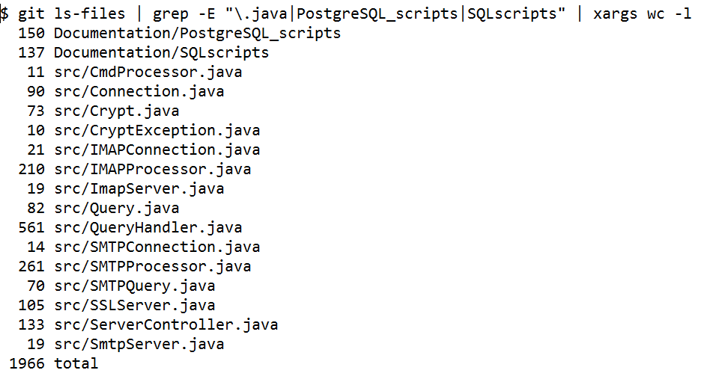
Metrics

Slide 29
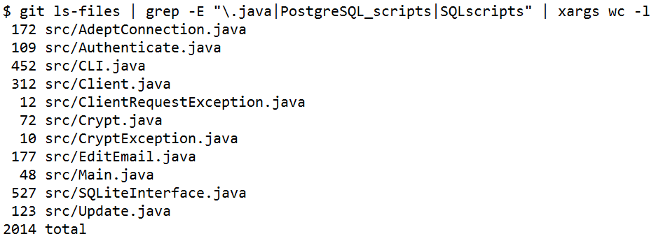
Metrics

Slide 30
Demonstration

Slide 31
Questions?

